Slide 1
Radiomics Project

Slide 2
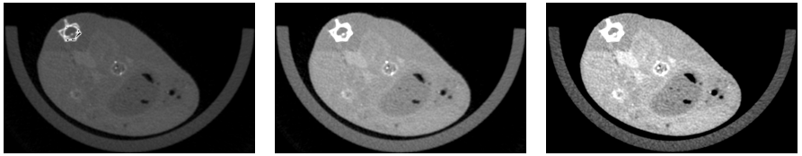
The Dataset
DICOM images were converted into PNGs
Naïve normalization
SimpleITK function
Aspose.Imaging for .NET

Slide 3
The Dataset
Patches: allow the model to learn local properties.
2D patches: ~16K tensors of 50X50. 50X50 tensor containing the matching mask is paired.
65% of the data used for training
The rest for testing.
3D patches: ~5K tensors of 30X30X30. Each tensor is a concatenation of 30 30X30. and is paired with another 30X30X30 tensor containing the matching mask.
65% of the data used for training
The rest for testing.

Slide 4
The Neural Networks
In this Project we used three different models to create varied results.
There are two main tasks: classification and segmentation.

Slide 5
The Neural Nets – Classification 2D
2D tensor → label
Label first determined using threshold:
More than 20% of the pixels are tumor→ 1 (has tumor)
Less → 0 (no tumor)
Loss: cross entropy
Neural Network architecture:
Convolution, ReLU
Convolution, batch norm, ReLU, max pool
Convolution, ReLU, max pool
3 FC: 2304 -->1500 --> 750 --> 2
Final test accuracy: 86.53%, within 12 epochs.

Slide 6
The Neural Nets – Classification 2D
Advantages:
Easily defined
Easy to evaluate
Disadvantages:
The task is imprecise
The network can learn heuristics
Quick convergence, “too good to be true”.

Slide 7
The Neural Nets – Classification 3D
3D tensor → label
Neural Network architecture: Similarly to classification 2D but with 3D convolutional.
Final test accuracy: 89.22% within 13 epochs
Advantages:
More information that the network can learn for each data sample
Spatial perspective
Better test loss results
Disadvantages
Less data samples
Similar to 2D – the task is imprecise

Slide 8
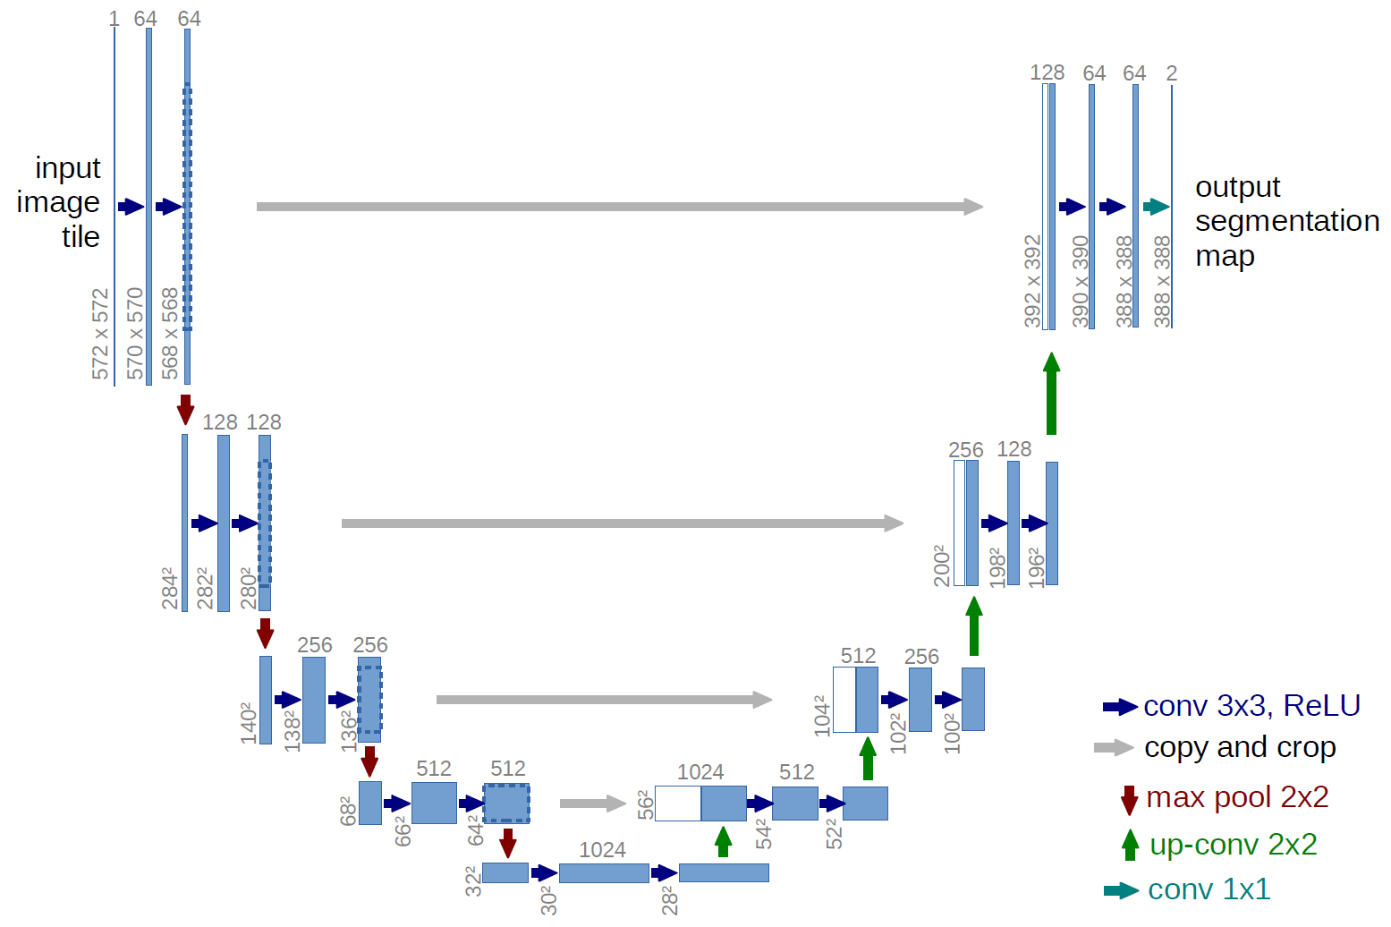
The Neural Nets – Segmentation
2D image tensors → 2D mask tensor
Loss: Dice coefficient
Accuracy: intersection over union (Jaccard index)
Architecture: simplified Unet - encoder and decoder:
Four downsampling layers
Four upsampling layers
Filters per layer: 16, 32, 64, 128
Final test accuracy*: 53% within 67 epochs

Slide 9
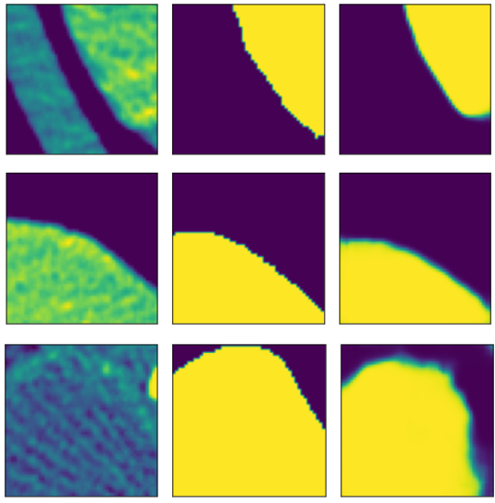
The Neural Nets – Segmentation
predicted mask
Patch
GT mask
Advantages:
More precise task
Less prone to overfit
Good visual result
Disadvantages
Harder task
Lowest accuracy of the three

Slide 10
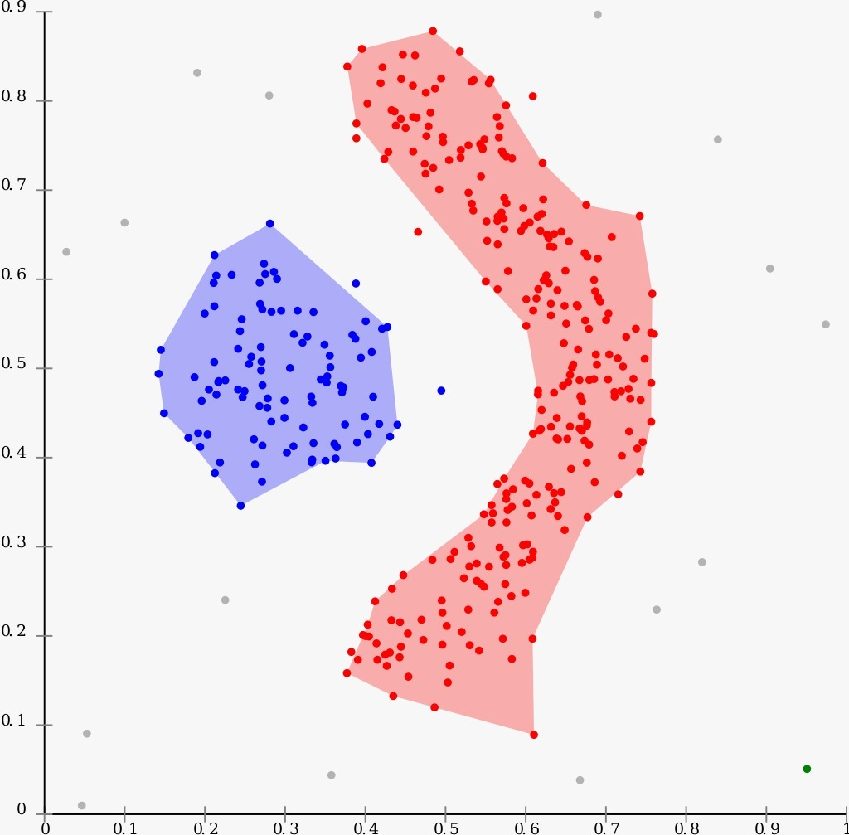
Clustering
Algorithm: DBSCAN – clusters are non-convex shapes, no a-priory number of clusters, handles noise (outliers)
Clustering only on tumor test samples.
Two parameters: ε and MinSamples
Features were extracted:
Classification 2D – FC layer 750
Classification 3D – FC layer 1024
Segmentation – activation map from last layer of the encoder (flattened to vector of size ~3000)

Slide 11
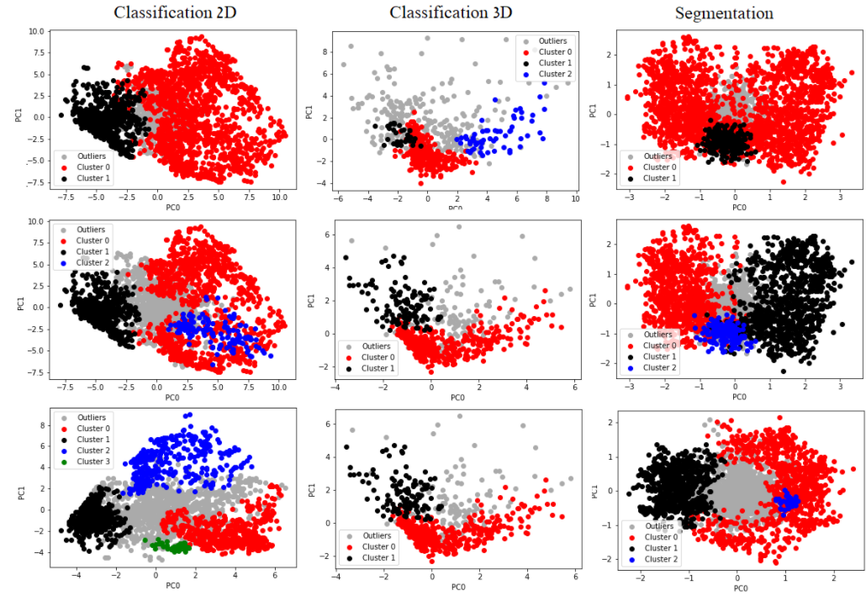

Slide 12
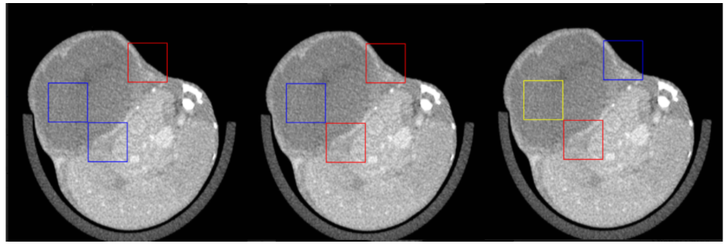
Patch Visualization
Each patch is colored according to its' cluster:
From left to right: classification 2d, segmentation with 2 clusters, segmentation with 3 clusters

Slide 13
Evaluation: Kaplan - Meier Analysis
KM Estimator: a descending function from time to [0,1], defined as the probability of survival, for a member of some group, in time t.
Given several groups, a large distance between the plots indicates a better clustering - more informative.

Slide 14
